Slide 1
Body size response to global changes: Testing the explanatory power of environmental anomalies
Nicolas Dubos
Isabelle Le Viol, Alexandre Robert, Céline Teplitsky, Olivier Dehorter,
Manon Ghislain, Romain Julliard & Pierre Yves Henry

Slide 2
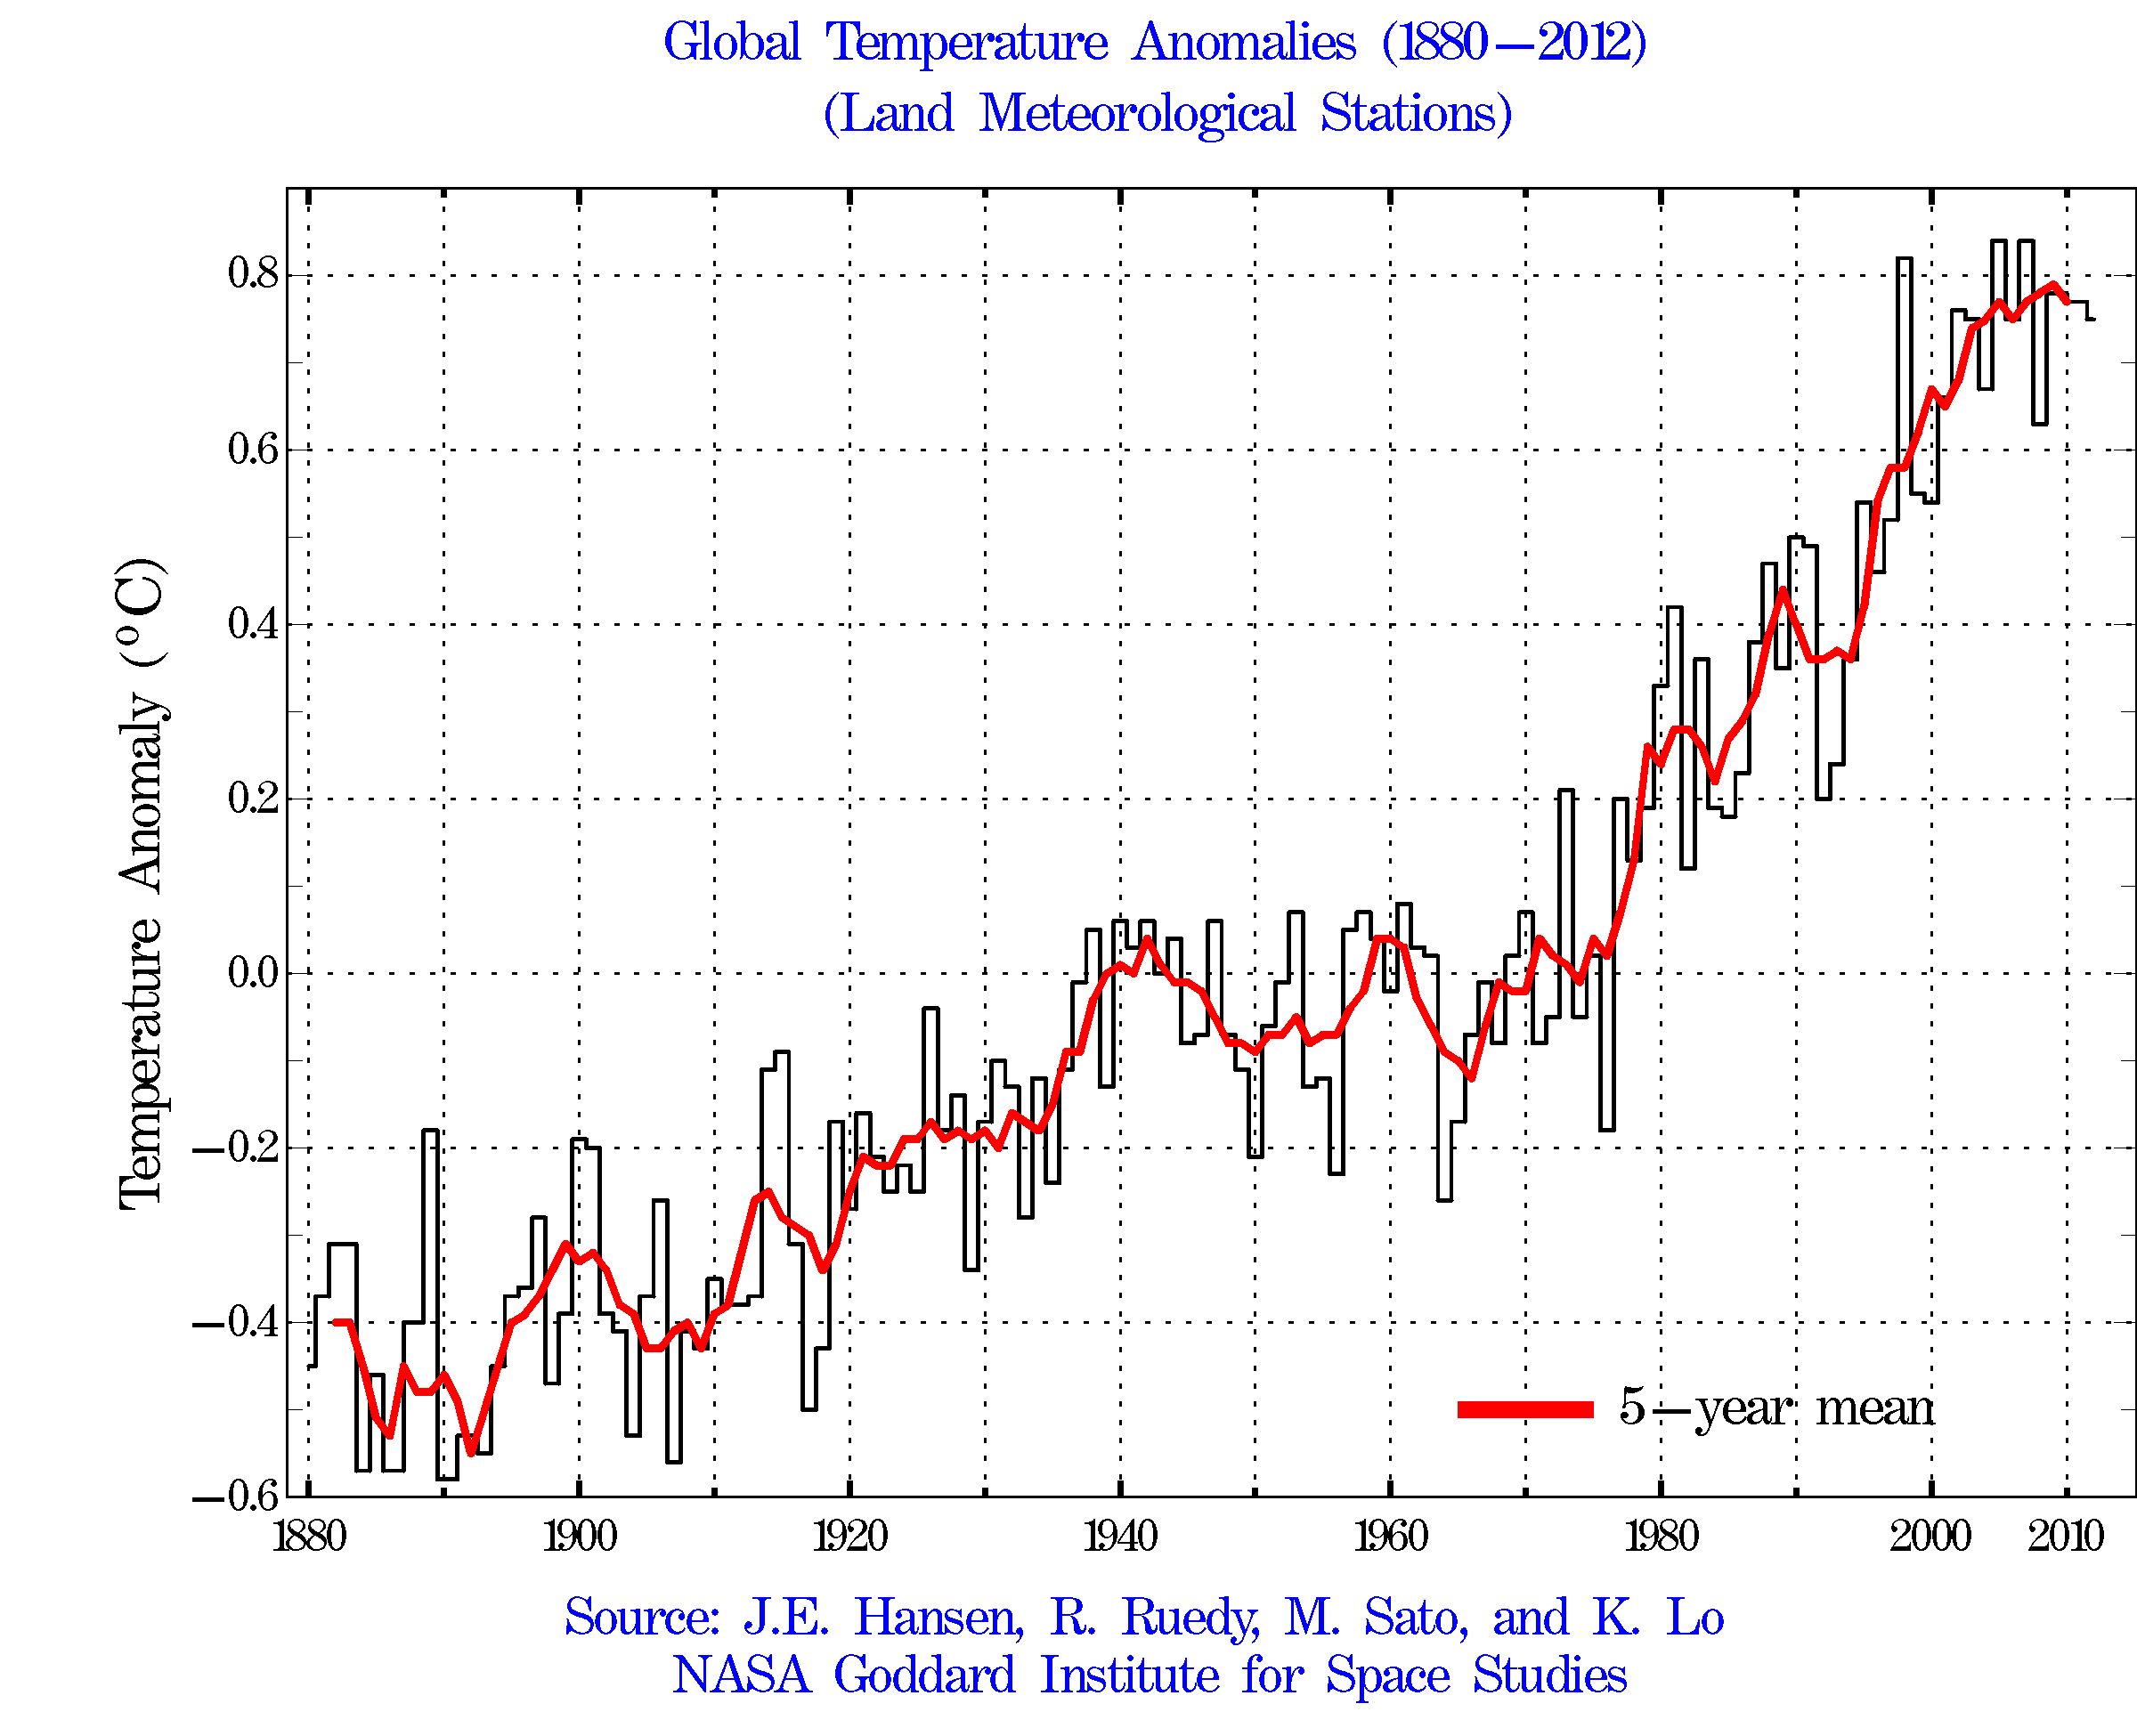
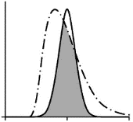
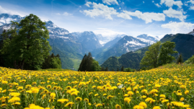
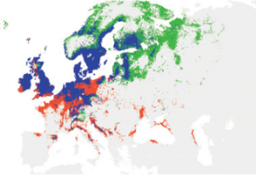
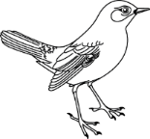
Introduction: Climate drives body size
Global changes
Climate warming
Species response:
Phenological shifts (Menzel et al. 2006)
Distribution changes (Root et al. 2003)
Body size decline (Yom-Tov et al. 2006, Edeline et al. 2013, Gardner et al. 2014, Gutièrez-Pinto et al. 2014 )

Slide 3
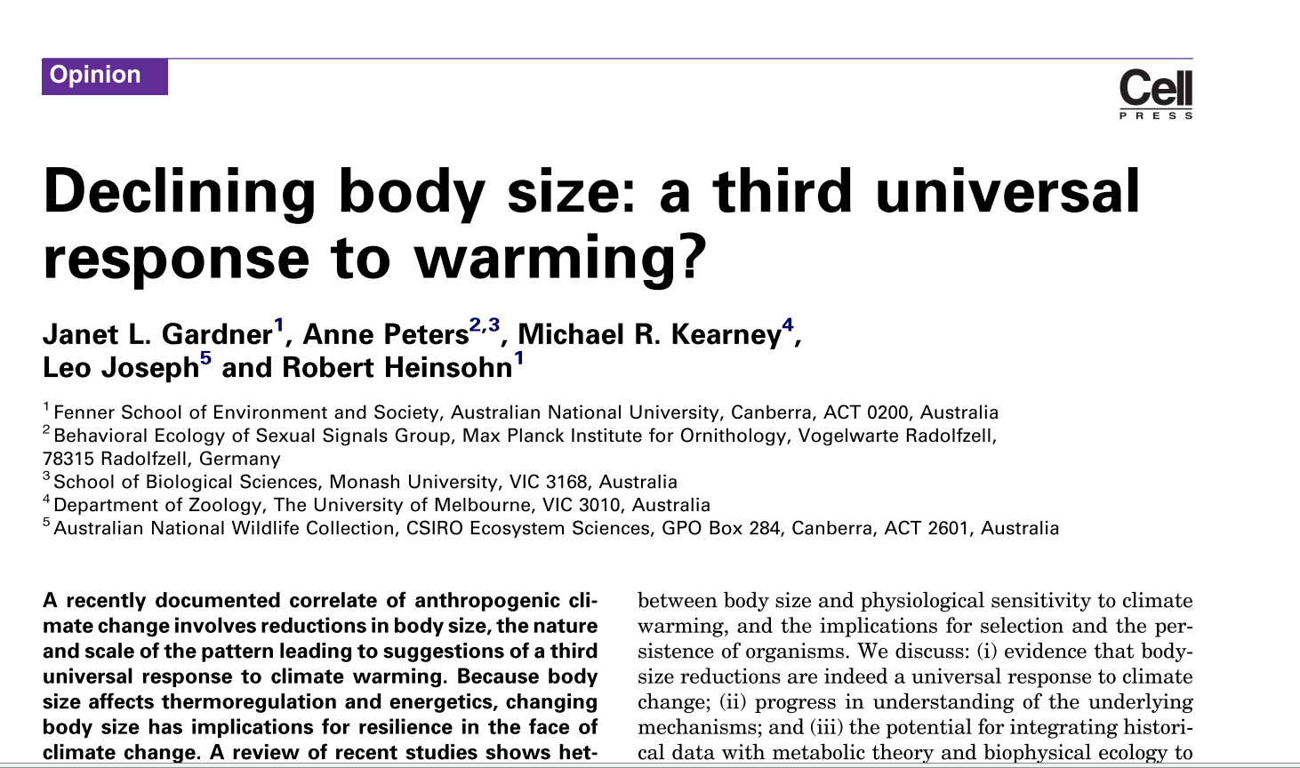
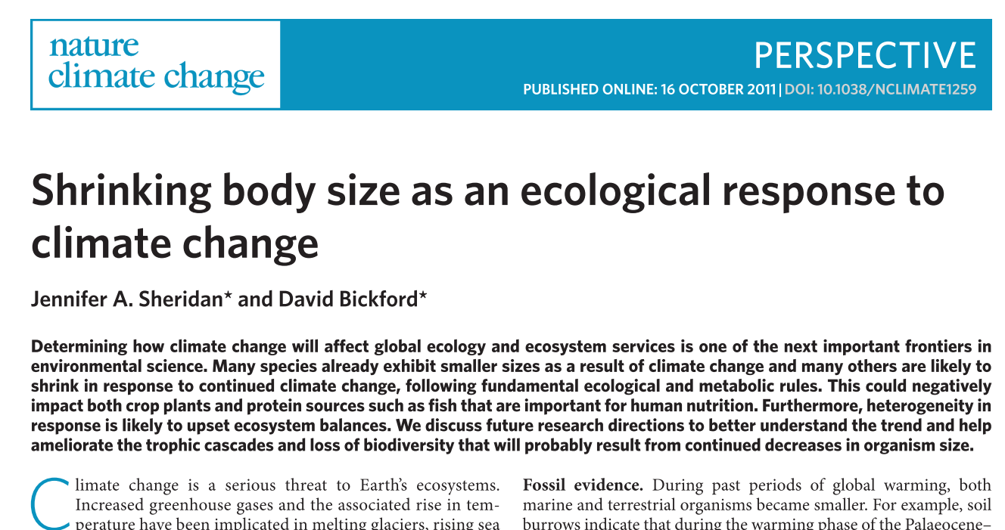
Climate drives body size
Third universal response to climate change?

Slide 4
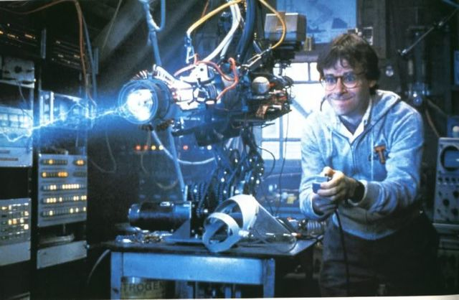
Climate change

Slide 5
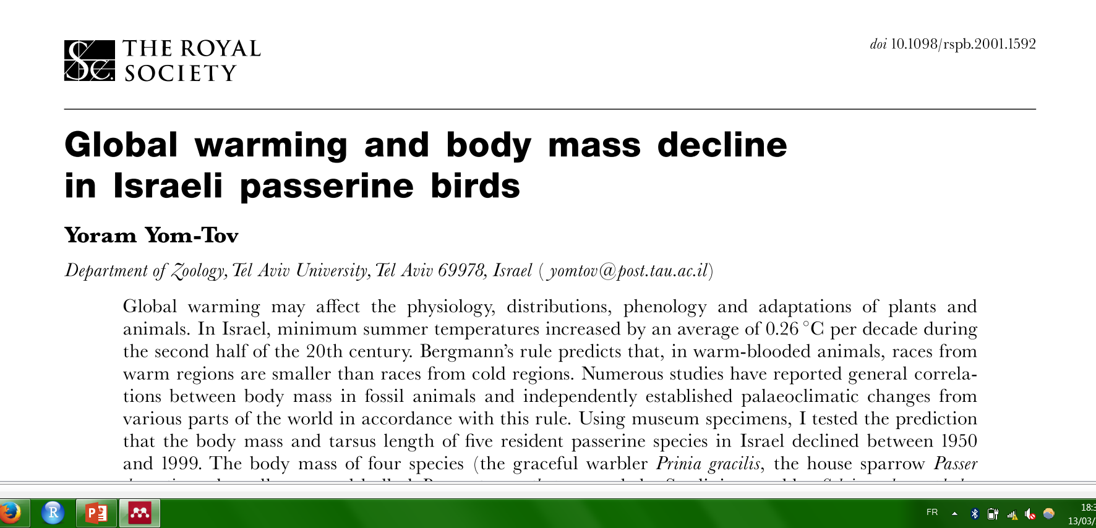
Climate change
?
Size change

Slide 6
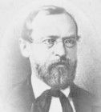
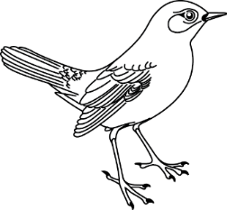
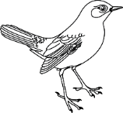
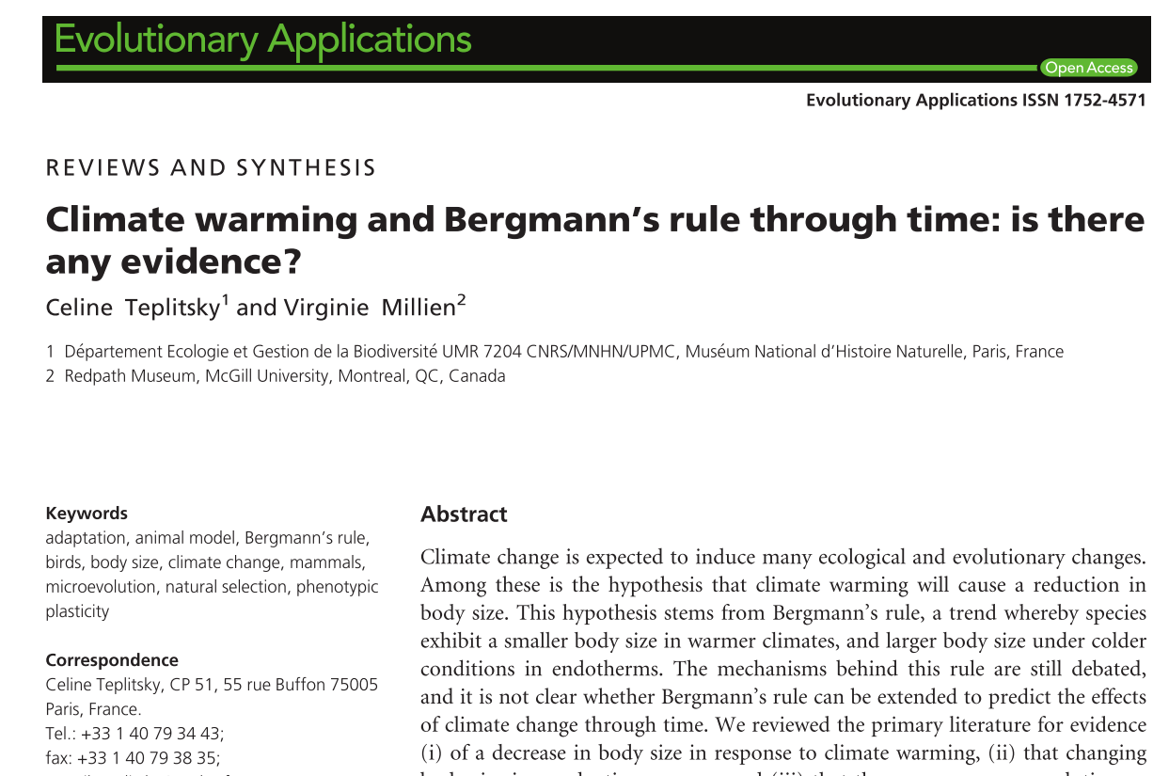
Driver = Temperature ?
Climate drives body size
Bergmann’s rule (1847)
Heat loss efficiency
Risk of hyperthermia

Slide 7
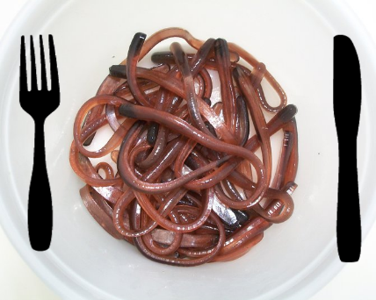
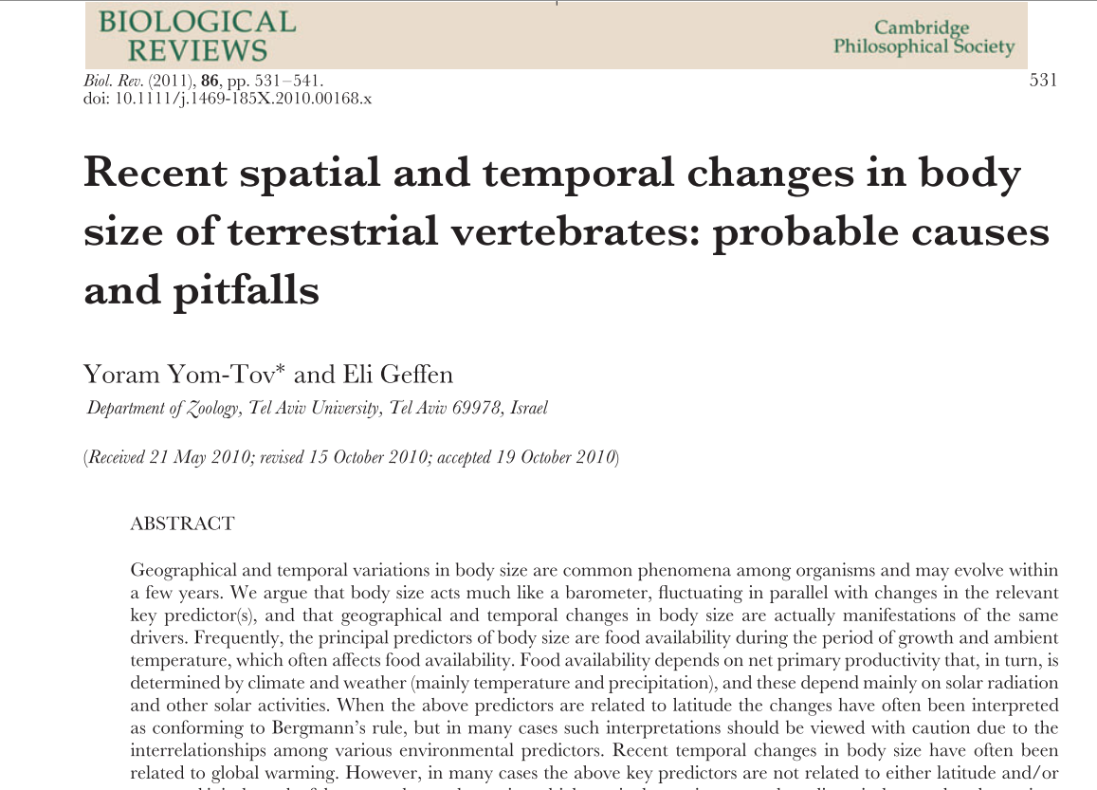
Climate change
?
Size change

Slide 8
Research questions

Slide 9
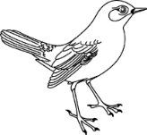
Research questions
1. Temporal trend
Size decline in temperate climate (France )?

Slide 10
Research questions
1. Temporal trend
2. Driver / Mechanism
Size decline in temperate climate (France )?
?
OR
?
Size
Environmental variable

Slide 11
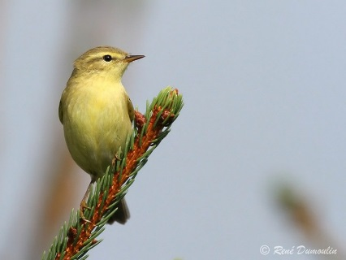
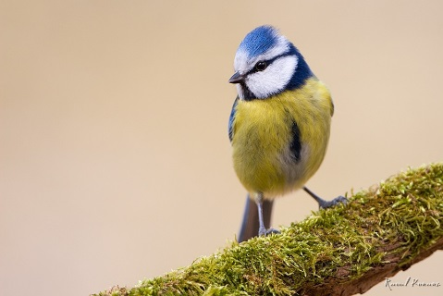
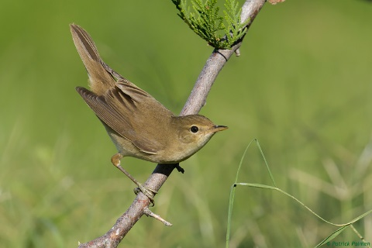
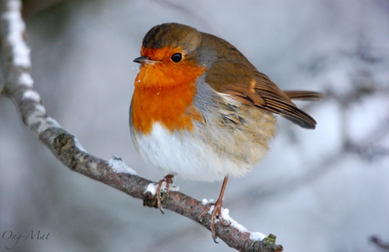
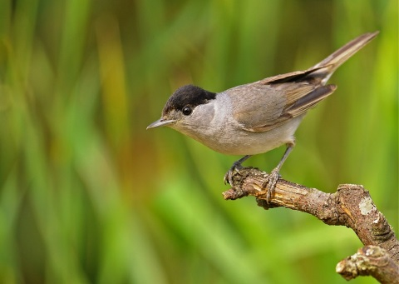
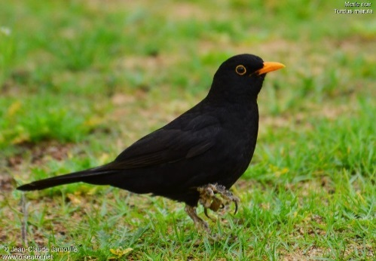
Research questions
1. Temporal trend
2. Driver / Mechanism
3. Comparative study
Size decline in temperate climate (France )?
OR
?
Different response between species? Why?

Slide 12
Data

Slide 13
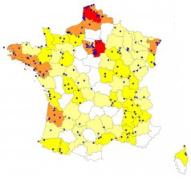
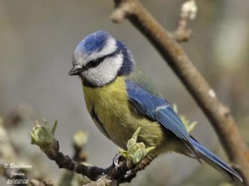
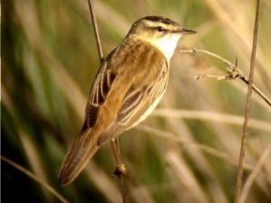
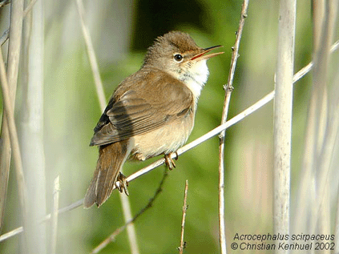
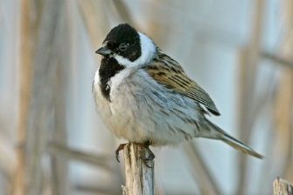
Data
French Constant ringing Effort Site (CES)
Multi-species
Multi-sites
Long term
41 species
>40000 biometric data
257 sites
Monitored at least 1 year
15 years
2000-2014

Slide 14
Measurement for body size?
Juveniles (assumption: body size => juvenile growth)
no moult
no between-year carryover effect

Slide 15
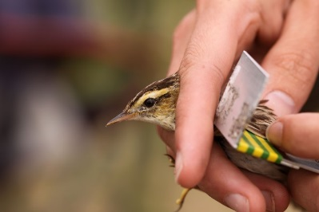
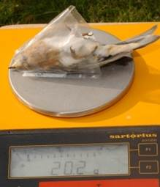
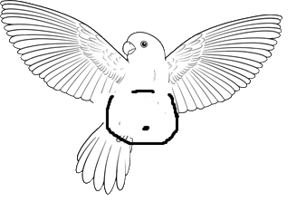
Measurement for body size?
Data
Wing length
Body mass
Body mass adjusted
to wing length (= Body condition)
Performed by trained ringers

Slide 16
Which environmental variables??
Data
Variable
Hypothesis (mechanism)

Slide 17
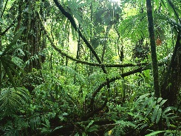
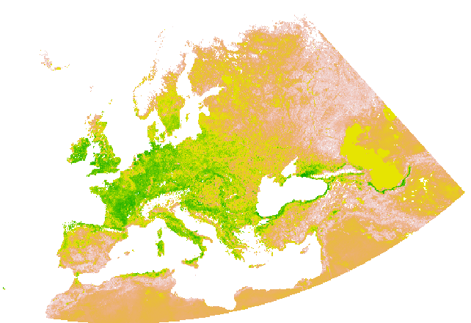
Which environmental variables??
Data
Variable
Hypothesis (mechanism)
Temperature anomaly
Heat loss efficiency
Precipitation anomaly
NDVI anomaly
Protein intake during growth

Slide 18
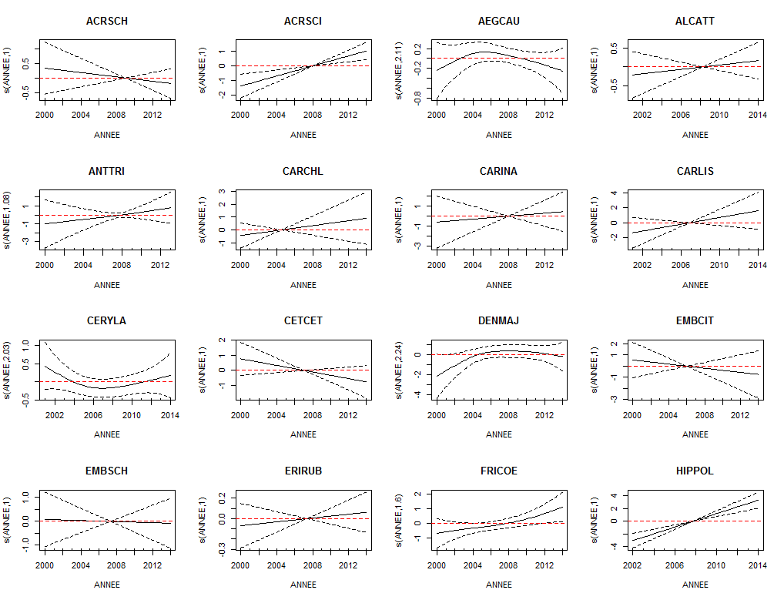
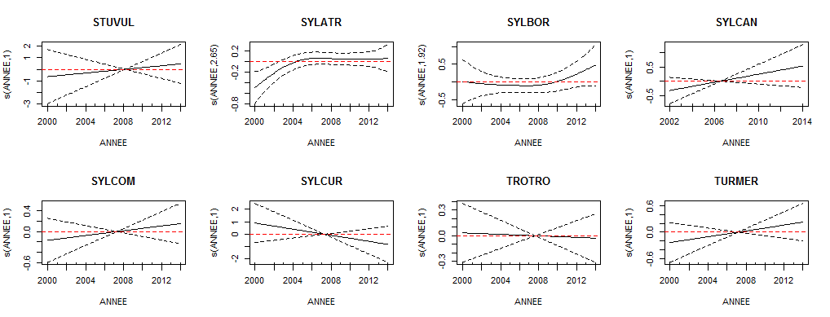
1. Temporal trends
Most species did not change

Slide 19
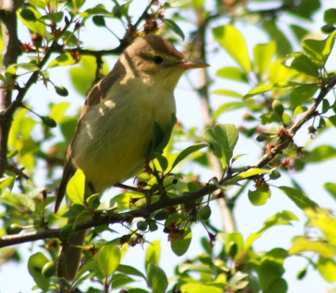
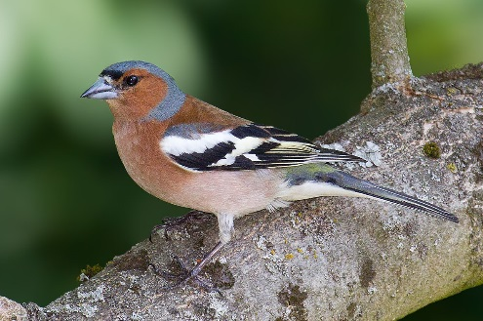
1. Temporal trends
Most species did not change
A few positive trends

Slide 20
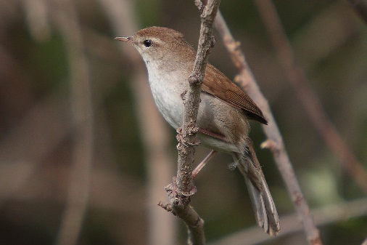
1. Temporal trends
Most species did not change
A few positive trends
One negative trend

Slide 21
2. Driver? Mechanism?
?
Size
Climatic variable

Slide 22
2. Driver? Mechanism?
Methods
Generalised linear mixed models (GLMM)
Multi-model Inference (variable importance)
?
Size
Climatic variable

Slide 23
Results
2. Driver? Mechanism?

Slide 24
Wing length ~ clim + NPP anomalies
2. Driver? Mechanism?
Variable importance
Σw = 0.58
^2
Σw = 0.20

Slide 25
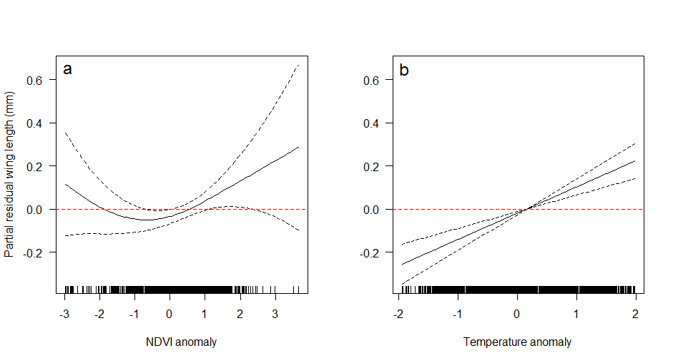
2. Driver? Mechanism?
Wing length ~ clim + NPP anomalies
Averaged model (weighted on AICw)
~
^2

Slide 26
2. Driver? Mechanism?
Wing length ~ clim + NPP anomalies
Averaged model (weighted on AICw)
Response = between species
~
^2
Weak effect: explains 6% of the temporal variance

Slide 27
Results
2. Driver? Mechanism?

Slide 28
Body mass ~ clim + NPP anomalies
2. Driver? Mechanism?
Best model (AIC)
* Species

Slide 29
2. Driver? Mechanism?
Body mass ~ clim + NPP anomalies
Best model
AICw = 0.87
* Species

Slide 30
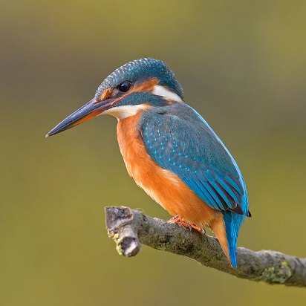
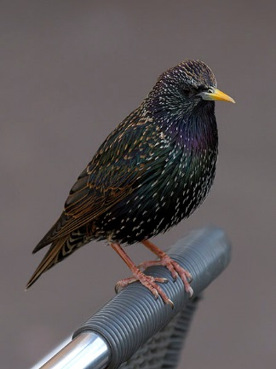
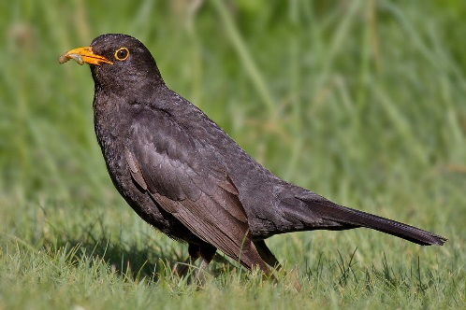
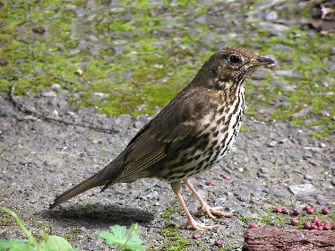
Mass ~ Precipitation*Species
Explains 20% of the temporal variance
NS
37 species

Slide 31
Wing length-adjusted body mass
Results similar from body mass

Slide 32
3. Different response between species?

Slide 33
3. Different response between species?
For body mass and « body condition »: Yes
* Species
3.1 Why?

Slide 34
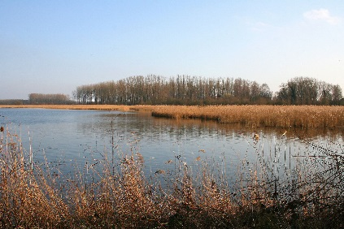
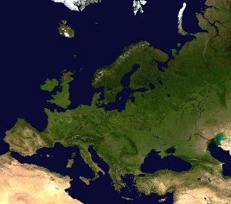
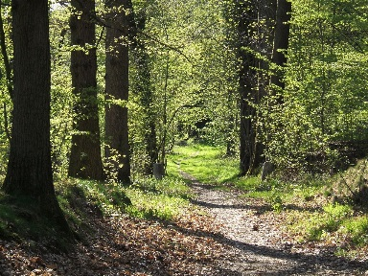
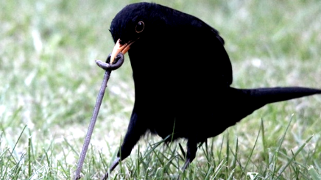
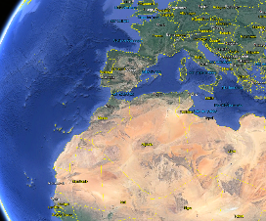
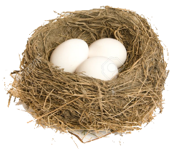
3. Different response between species?
Traits
Habitat specialisation
Breeding habitat type
Thermal specialisation
Migration strategy
Number of brood
Prefered feeding substrate
Ecological traits
Natural history traits
Picture Credit: Gareth aka Rhonddaborn on Flickr

Slide 35
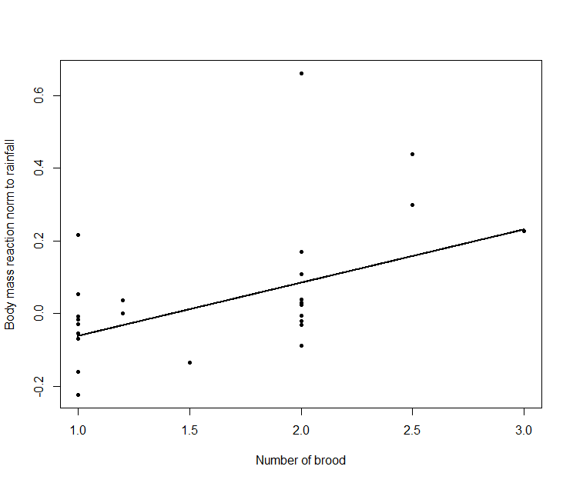
Multiple breeders are more sensitive
3. Different response between species?
**
~
±SE

Slide 36
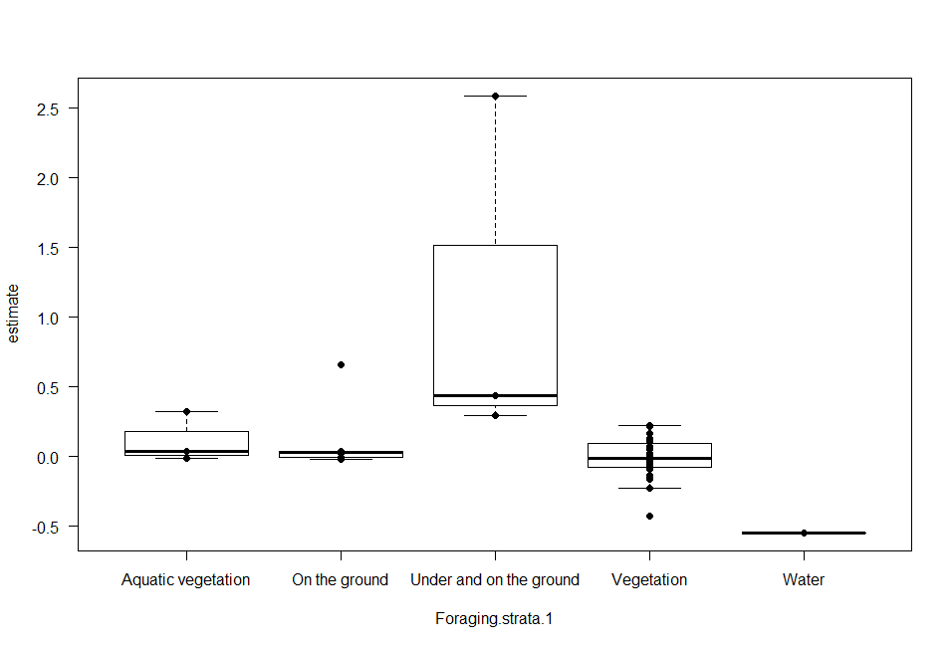
3. Different response between species?
Positive effect of precipitation
Prefered substrate = ground + under ground **

Slide 37
Discussion

Slide 38
Discussion: 1. Temporal trend
Some species shrink (very few here)

Slide 39
Discussion: 1. Temporal trend
Some species shrink
Some species increase

Slide 40
Discussion: 1. Temporal trend
Some species shrink
Some species increase
Most species do not change

Slide 41
Discussion: 1. Temporal trend
Single-species
Some species shrink
Some species increase
Most species do not change
Multi-species

Slide 42
Discussion 2. Body size dependence on climate

Slide 43
Discussion 2. Body size dependence on climate
>
Main driver = Food

Slide 44
Discussion 2. Body size dependence on climate
Temperature?
Not in France (neither in Germany)

Slide 45
Discussion 2. Body size dependence on climate
Temperature?
Temperature is not a major stress
In tempetare climate
Tewksbury et al., 2008. Science, 320:1296-1297

Slide 46
Discussion 2. Body size dependence on climate
Universal response to warming? => Depends on the latitude?

Slide 47
Discussion 2. Body size dependence on climate
NDVI (‘best variable’) => Low explanatory power

Slide 48
Discussion: 3. Differential response between species?
Wing length : No
Mass : Sensitivity depends on breeding and foraging strategy

Slide 49
Discussion: 3. Differential response between species?
Réponse détectée pour les grandes espèces
Effet de la précision?

Slide 50
Summary
Body size fluctuations: Minority of species
Food = main driver
Need to account for:
Latitude?
land use change?
Human appropriation of resources?
But Low explanatory power

Slide 51
Bonus : Quelle proportion de mesures au 1/2mm près ?
Pour chaque bagueur avec > 30 mesures
Combien de mesures XX.0
Combien de mesures XX.5

Slide 52
Bonus : Quelle proportion de mesures au 1/2mm près ?
Pour chaque bagueur avec > 30 mesures
Combien de mesures XX.0
Combien de mesures XX.5
Attendu dans l’idéal: 50% de mesures XX.5

Slide 53
Bonus : Quelle proportion de mesures au 1/2mm près ?
Pour chaque bagueur avec > 30 mesures
Combien de mesures XX.0
Combien de mesures XX.5
Réalité

Slide 54
Bonus : Quelle proportion de mesures au 1/2mm près ?
Pour chaque bagueur avec > 30 mesures
Combien de mesures XX.0
Combien de mesures XX.5
Mesureurs au 1/2mm

Slide 55
Bonus : Quelle proportion de mesures au 1/2mm près ?
Pour chaque bagueur avec > 30 mesures
Combien de mesures XX.0
Combien de mesures XX.5
Mesureurs au 1mm
Mesureurs au 1/2mm

Slide 56
Bonus : Quelle proportion de mesures au 1/2mm près ?
Pour chaque bagueur avec > 30 mesures
Combien de mesures XX.0
Combien de mesures XX.5
Mesureurs au 1mm
Mesureurs au 1/2mm
Mesureurs au 1/2mm mais qui arrondissent au mm "trop souvent"

Slide 57
Acknowledgements
Data gatherers: All the 442 volonteer ringers
My supervisors: I. Le Viol P.-Y. Henry
Helpers: Manon Gislain, Pierre Fiquet, Vincent Devictor, Eric Edeline, Boris Leroy, Morgane Barbet-Massin, Karine Princé, Reto Schmucki, Frederic Jiguet, Romain Julliard
Funder: LabEx BCDiv
Listeners: you
Contact: nicolas.dubos@mnhn.fr
THANKS

Slide 58
Reaction norm of climate and NDVI
2. Driver? Mechanism?
Species do not shrink when NDVI is lower
Low food availability => adults produce less chicks ?
More food for chicks

Slide 59
Body size dependence on climate
Counteracting effects of temperature within year ?

Slide 61
Raction norm body size climate / Net Primary Production
Controling for ...
Species variation (fixed effect)

Slide 62
Raction norm climate / Net Primary Production body size
Controling for ...
Species variation (fixed effect)
Wing growth (juveniles) (fixed effect of julian date)
Wing length
Julian days

Slide 63
Raction norm climate / Net Primary Production body size
Controling for ...
Species variation (fixed effect)
Wing growth (juveniles) (fixed effect of julian date)
Change in protocol (new recommandations in 2000)

Slide 64
Raction norm climate / Net Primary Production body size
Controling for ...
Species variation (fixed effect)
Wing growth (juveniles) (fixed effect of julian date)
Change in protocol
Random observer variation (random effect observer)
+ checking for observer repeatability
Random variation in space (random effect of site)
Random variation in time (random effect of year)

